Slide 1

Personal shopper for Hyper Panda

Slide 2
CONTENTS
Introduction ( history , requirement )
Vision and goal
Timeframe
Resources
Budget
Risks and issues
Implications
Success criteria

Slide 3
History
Panda Retail Company is a Saudi Arabian grocery retailing company
United Panda Co., with a capital of SR 207.50 million, was founded in Riyadh in 1981.
Initially, the corporation sold and imported foodstuffs, clothing, luxury items, and electrical appliances.
In September 1993, Prince Al-Waleed bin Talal purchased 50.1 percent of the company, which had sixteen supermarkets in Riyadh and two in Jeddah, at a time when it was losing money. Following the acquisition, Al-Waleed merged his retail company Al-Azizia Markets Co. with United Panda Co. to form Al Azizia Panda United, of which he became chairman.

Slide 4
Vision and Goals
Our vision is to create a better everyday life for the many people
by offering new services to our high-value clients
To serve a large segment of society, especially the elderly
To Reduce time and effort
To Facilitate the purchase process

Slide 5
Requirements
A business represented in the retail sector, represented by a supermarket, aims to sell canned foods and beverages, in addition to oils, grains, meat, dairy, cheese, and other foodstuffs electronically, where the order is made through the device and there is no need to go to each food row alone.

Slide 6
Deliverables
Project Deliverables
Title | Description | Notes
Prepare project plan | Identify the milestone and timelines of the project | Complete
Design the wireframes | Design the layout of the system | In progress
Design rewards | Design the layout of the application | In progress
Product tracking | The ability to track your product through the system | Not started
Editing order | The ability to edit orders even after summiting it | Not started
Payment | Design the payment function | Not started

Slide 7
Timeframe
Our project time frame will take up to approximately 5-6 months
started at October 25th and will end on the third of January 2022.
are the period within which certain events are scheduled to occur.

Slide 8
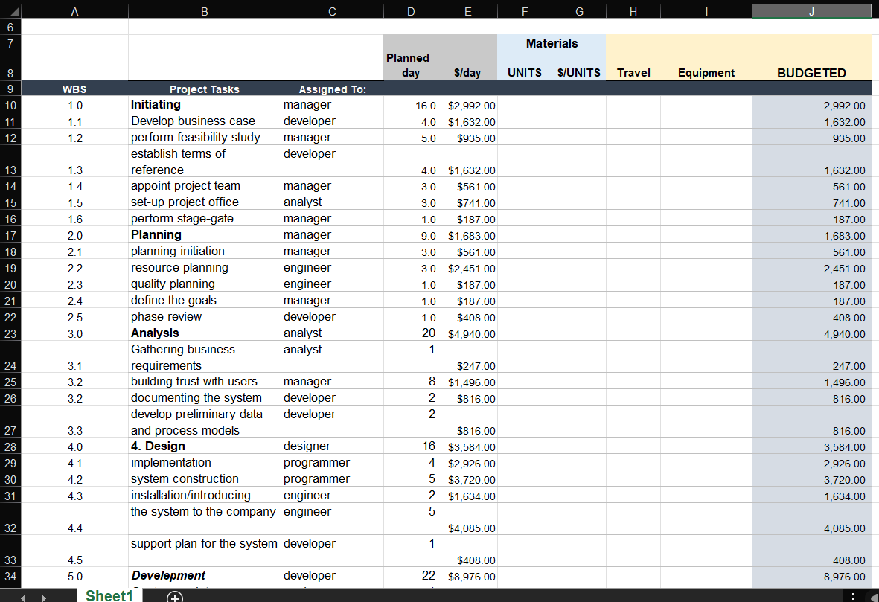
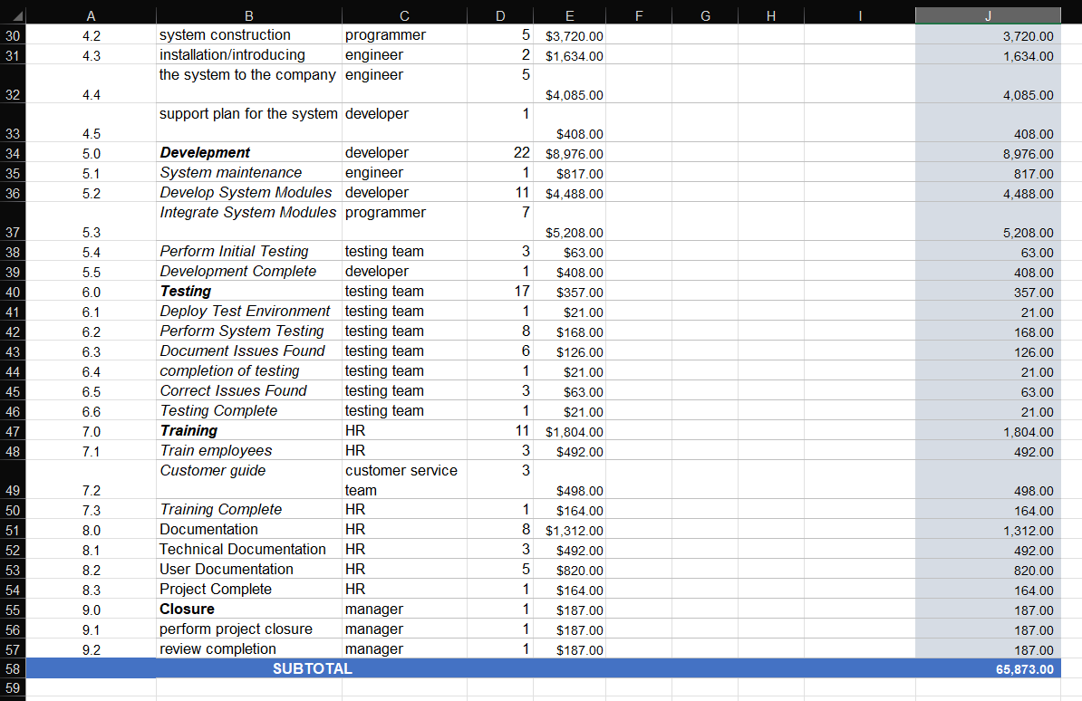
budget
The budget decided is $65000.00
As it shows the cost estimates the project is under budget

Slide 9
Recourses
Project Resources
Type | Quantity | Notes
Designers | 4
Programmers | 3
Analysts | 4
Human resources | Team contain 7 people maybe
The main source of work is the sources and our system needs programmers, designers, analysts, as well as engineers to maintain the system in the event of its failure, but we do not have a delivery because it depends on screens and devices.

Slide 10
Project Risks(1)
A project risk is an uncertain event that may or may not occur during a project.
Technical Risk
Financial Risk
People Risk

Slide 11
Technical Risk Problems that could face the software of the project Financial Risk The possibility of losing money on an investment People Risk Problems with staff scheduling, personal issues, sick days and family emergencies
Project Risks(2)

Slide 12
Project Issues(1)
Is a problem that has been encountered in executing project activities.
Technical Issues
Change management
Budgeting issues

Slide 13
Project Issues(2)
Technical Issues Developers can't find the root cause of a defect in software
Change in management Changing management can lead to difficulties in communications which can cause delays and interruption
Budget Issues Inaccurate or unreasonable assumptions can make a budget unrealistic

Slide 14
Implications(1)
Wasted a lot of time and effort
number of customers decrease
Bad reputation

Slide 15
Implications(2)
Wasted a lot of time and effort: Waiting for a queue takes a long time and requires some effort, especially for the elderly
number of customers decrease:
Some do not have the ability to stand for a long time because of two products or one product and others do not have patience, so if there is no application that serves them, they will not be able to pay for the product in a short time
Bad reputation :
When introduce a self-pay service, the reputation will spread from the store and more people will appear. Because a bad reputation is very annoying and affects the progress of the store.

Slide 16
Success Criteria
Ease of use
Development and Quality
Interface design
Initial test of the system

Slide 17
Ease of use
This factor is very important and it should be suitable for use by all ages, because this is how customers are attracted, so people prefer to use an easy, clear and fast screen interface in implementing anything

Slide 18
Development and Quality
It is necessary to constantly develop and update the system,
Every product should create a questionnaire for customers to find out the feedback and problems that annoy them
Also, technical support must be provided to communicate and help when there is any problem

Slide 19
Interface design
One of the factors that the interface designer should focus on. Many people prefer the system interfaces organized, clear and easy to use.
You must also pay attention not to use colors that are harmful to the eye and also not to put a lot of commands and buttons, especially on the main page of the interface

Slide 20
Initial test of the system
The company that designed the system must perform a preliminary test of the system on a certain class of people before it is officially put on the market so that the defects in the system can be identified and fixed

